Slide 1
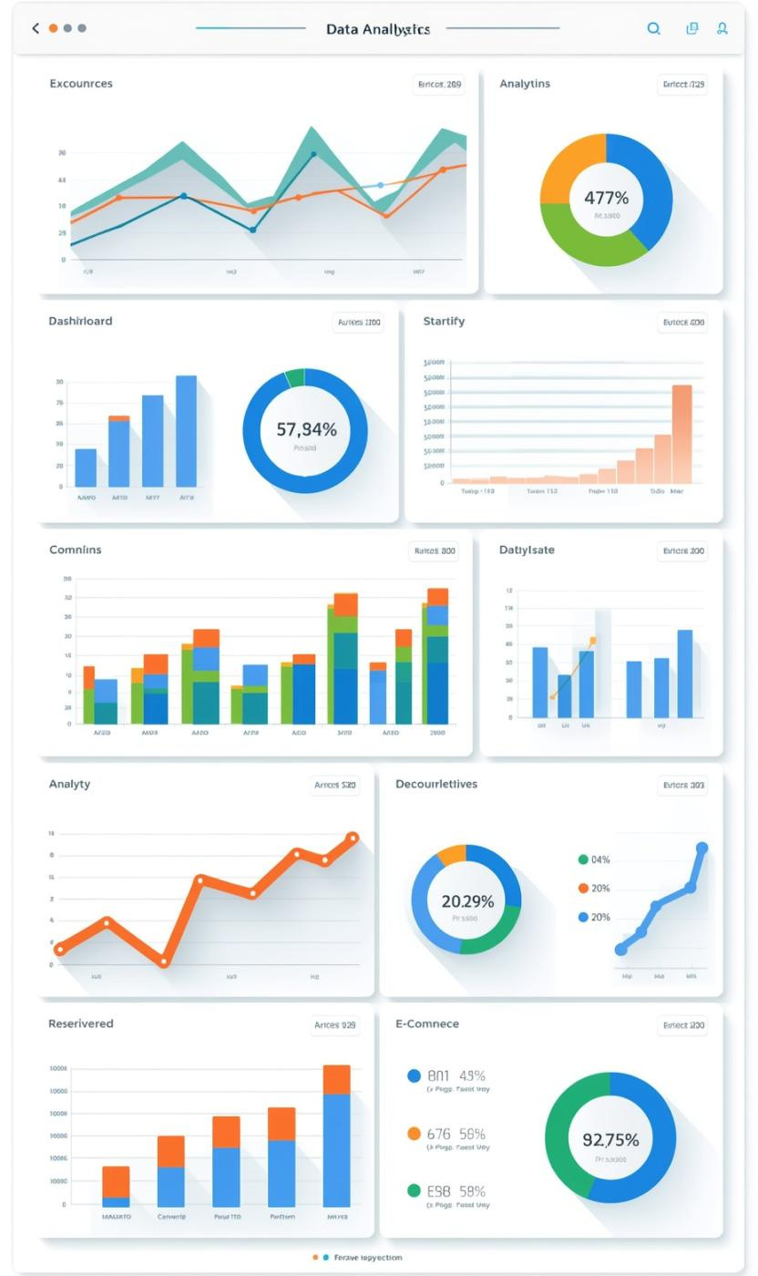

Aventra Commerce: Affiliate Marketing Analytics
ALVIN FRANCIS FERNANDES
2026-03-21

Slide 2

Business Problem Overview
AVENTRA COMMERCE CHALLENGES
Aventra Commerce, a mid-sized e-commerce marketplace, faces several core challenges:
Inconsistent conversions across various markets and devices.
Many users remain stuck in early funnel stages.
The impact of discounts on conversions is unclear.
Low ROI from specific traffic sources.

Slide 3
Executive Summary Insights
TOP REVENUE MARKETS
Canada and the US lead revenue generation, showcasing strong commission values that provide a solid foundation for future growth initiatives.
BEST TRAFFIC SOURCES
Organic Search and Social Media emerge as the most effective traffic sources, delivering high conversion rates and substantial revenue contributions.
MOBILE CHALLENGES
While mobile devices drive awareness, they struggle with low conversion rates, indicating a need for improved user experience and optimized checkout processes.

Slide 4
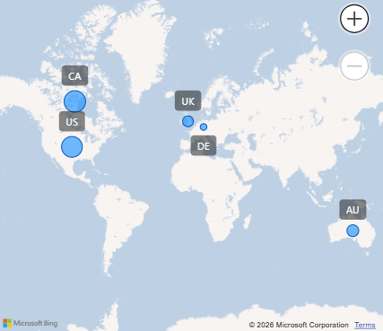
Market Performance Insights and Revenue
REVENUE AND ENGAGEMENT OVERVIEW
Canada leads with $297 in commission, followed closely by the US at $275. Germany and Australia show promising engagement levels.

Slide 5
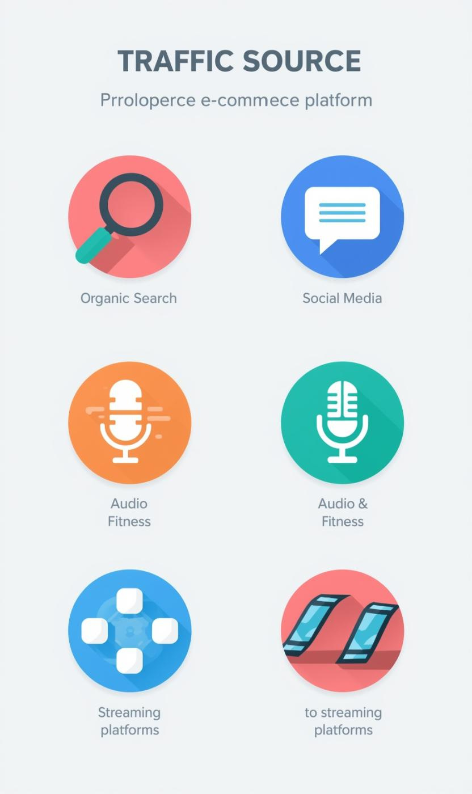
Traffic Source Effectiveness
ANALYZING PERFORMANCE ACROSS KEY CHANNELS
Organic Search: highest conversion rates
Social Media: largest engaged user base
Audio & Fitness: high commission per conversion
Streaming: lowest conversion rate observed

Slide 6
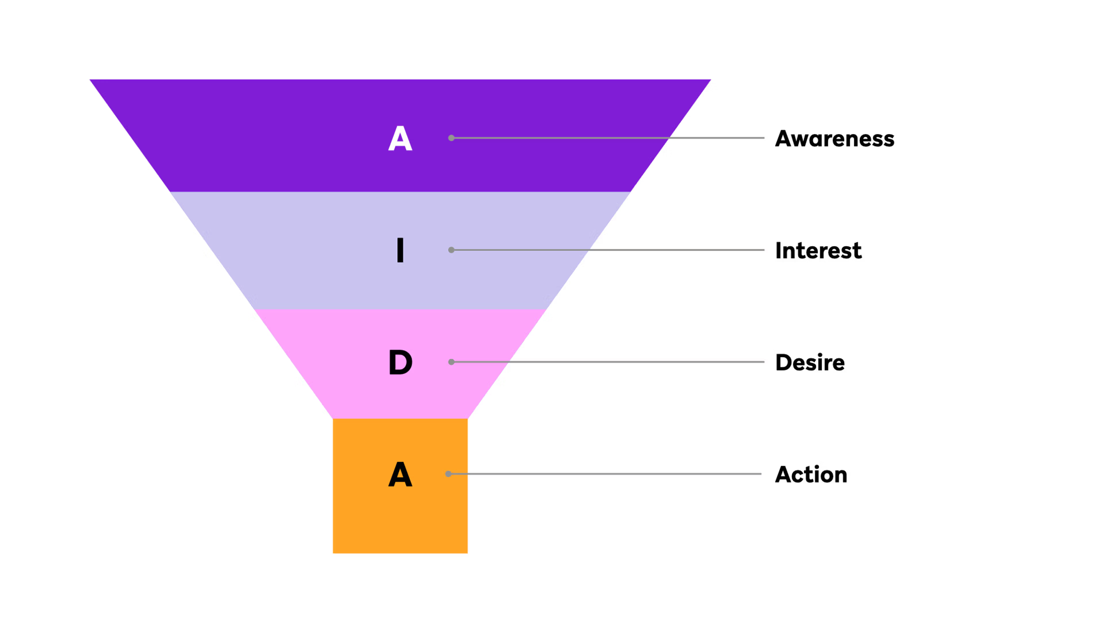
Funnel Analysis
DEVICE PERFORMANCE INSIGHTS IN USER BEHAVIOR
User behavior analysis reveals that mobile devices generate high awareness but suffer from low purchase rates, while desktops show smoother progression through the purchasing funnel.

Slide 7

Understanding User Engagement in Digital Marketing
Analyzing user engagement reveals that time on page is not correlated with conversions, highlighting the effectiveness of Social Media in driving interactions.

Slide 8

Product & Pricing Strategy
INSIGHTS ON CATEGORIES AND DISCOUNTS
Electronics and Kitchen dominate sales
Discounts drive 68% of conversions
Moderate discounts maximize overall revenue
High discounts reduce profitability
Furniture category underutilized for commissions

Slide 9
Recommendations for Improved Performance
STRATEGIC INSIGHTS AND ACTIONS

Slide 10
Optimize Mobile Conversion Strategies
ENHANCE USER EXPERIENCE
Simplify mobile checkout flows
Optimize landing pages, clearer call-to-action buttons
Implement a user-friendly interface
Streamline payment options

Slide 11
High-Performing Channels & Markets
MEDIA CHANNELS WITH POTENTIAL
Investing further in Organic Search and social media will capitalize on high conversion rates and strong engagement.
Optimize Audio and Fitness platforms to improve conversion efficiency, as they already generate high commission per sale.
01
02
AUSTRALIA AND GERMANY
Expanding marketing efforts in Germany and Australia can leverage high engagement and average order values, tapping into these markets for greater revenue potential and brand recognition.

Slide 12
Refine Discounting Strategy
01
TIERED DISCOUNTS
Implement a tiered discount strategy that maintains moderate discounts (10–20%) as a standard, increasing during peak seasons to drive sales while maximizing profitability.
02
PRODUCT PROMOTION
Actively promote Electronics, Kitchen, and premium appliances to harness their high commission potential. Furthermore, promote Furniture category to add another high commission category to our business.

